Slide 1
Lecture 20
Cryocoolers
J. G. Weisend II

Slide 2
Goals
Introduce the characteristics and applications of cryocoolers
Discuss recuperative vs. regenerative heat exchangers
Describe regenerator materials
Describe the Stirling cycle, Gifford McMahon and pulse tube cryocoolers and give examples

Slide 3
Introduction to Cryocoolers
Cryocoolers are smaller closed cycle mechanical refrigeration systems
  There is no official upper size for a cryocooler but typically these provide less than few 100 W of cooling at 20 – 100 K and less than 10 W at 4.2 K
  Cryocoolers do not use the Claude/Collins cycles used by large refrigeration plants but use alternative cycles
  Working fluid is almost always helium – some exceptions exist
  All the laws of thermodynamics still apply
  Improved technology ( bearings, miniaturized compressors, better materials, CFD, better reliability etc) has lead to the development of a large number of practical cryocooler designs in the past 10 – 20 years
  We will concentrate on 3 types: Stirling, Gifford McMahon & Pulse tube

Slide 4
Cryocooler Applications
Cryocoolers are most useful in applications that:
  Have smaller heat loads ( < 1 kW)
  Operate above 10 K (though there are significant 4.2 K applications)
    Note synergy with HTS operating temperatures
  Require small size, weight, portability or operation in remote locations – space and military applications
  Are single cryogenic applications within a larger system – reliquefiers for MRI magnets, sample cooling, “cooling at the flip of a switch”

Slide 5
Cryocooler Applications
  Cooling of infrared sensors for night vision, missile guidance, surveillance or astronomy
    Much IR astronomy requires < 3 K and thus can’t be met by cryocoolers
  “Cryogen free” superconducting magnets or SQUID arrays
  Reliquefing LN₂,LHe or other cryogens
  Cooling of thermal radiation shields
  Cooling of HiTc based electronics e.g. microwave filters for cell phone towers
  Cooling of electronics for superconductivity or low noise (radio astronomy)
  Cryopumps for high vacuum (down to about 15 K)
  Becoming more common in accelerator labs for stand alone magnets and experiments

Slide 6
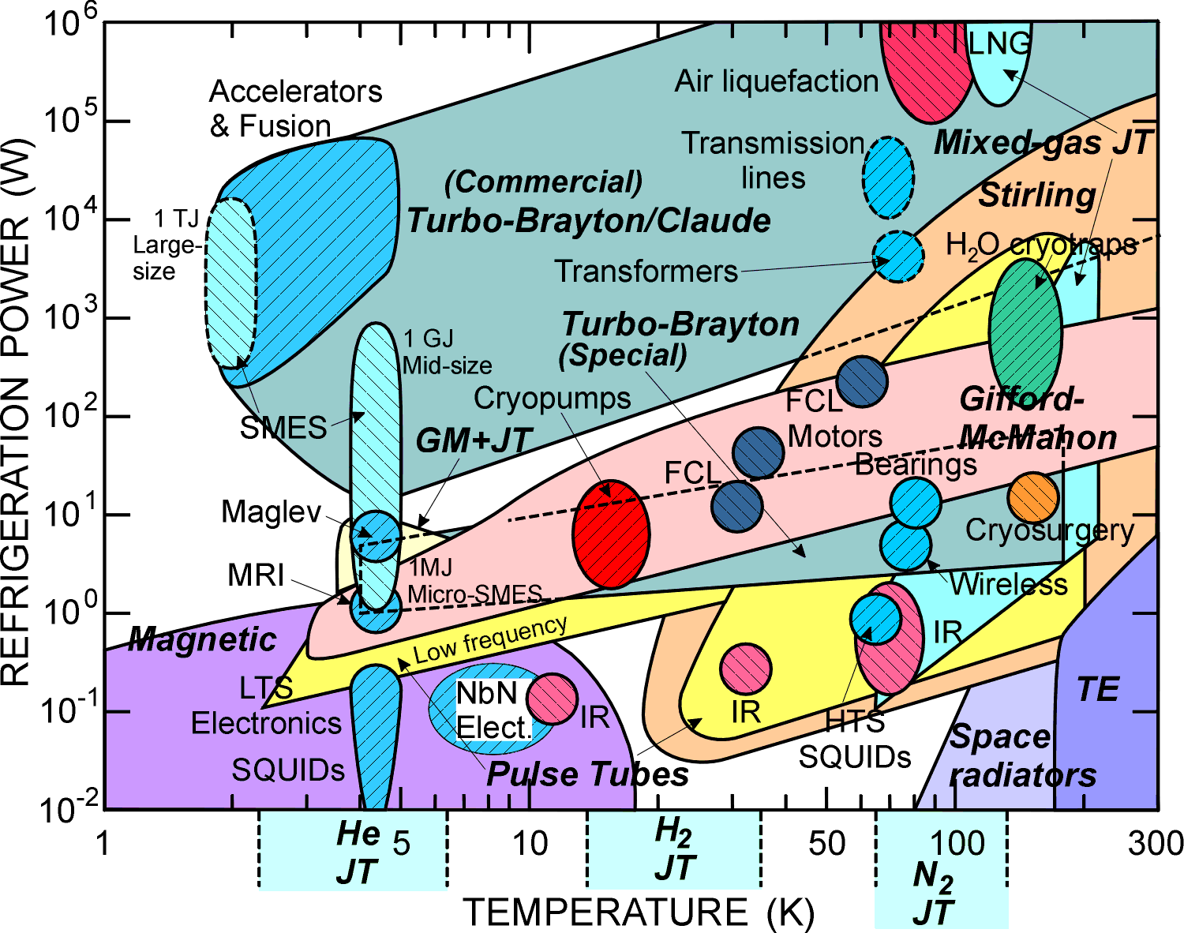
Crycooler Types and Applications
Courtesy
R. Radebaugh

Slide 7
Potential Disadvantages of Cryocoolers
Smaller capacity at lower temperatures
Vibrations
Reliability
Efficiency
  Can be as low as 1 % Carnot at 4 K ( compared to > 20% for large Collins cycle plants)
Cost (in particular as compared to bulk liquid)

Slide 8
Recuperative & Regenerative Heat Exchangers
Recuperative
  Flows are separated by a wall and only heat is transferred
    Plate fin or shell and tube heat exchangers are the most common examples
    Very common in large cryogenic refrigerators and in everyday life
    Allows continuous flows
Regenerative
  Warm and cold flows pass through the same material ( known as a regenerator) at different phases of the cycle. The regenerator absorbs the heat from the warm stream and releases it into the cold stream
    Very common in cryocooler cycles
    Generally results in oscillating flows
    Required advances in regenerator materials
Cycles that use these different types of heat exchangers can be classified at recuperative or regenerative

Slide 9
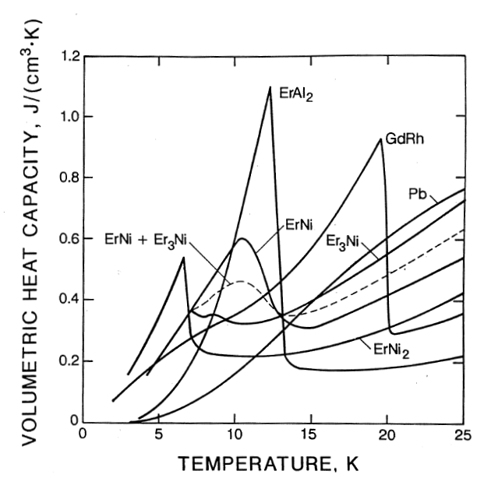
Regenerators
Efficient regenerators should
  Contain a large amount of surface area for heat transfer
    Thus are typically made of fines divided wire mesh or spheres
    Have a large specific heat over their operating temperatures
    Produce a low pressure drop in the working fluid
Pb, Er and Gd compounds are frequently used as regenerator materials
  In some designs, the regenerator material is optimized by temperature & position within the regenerator

Slide 10
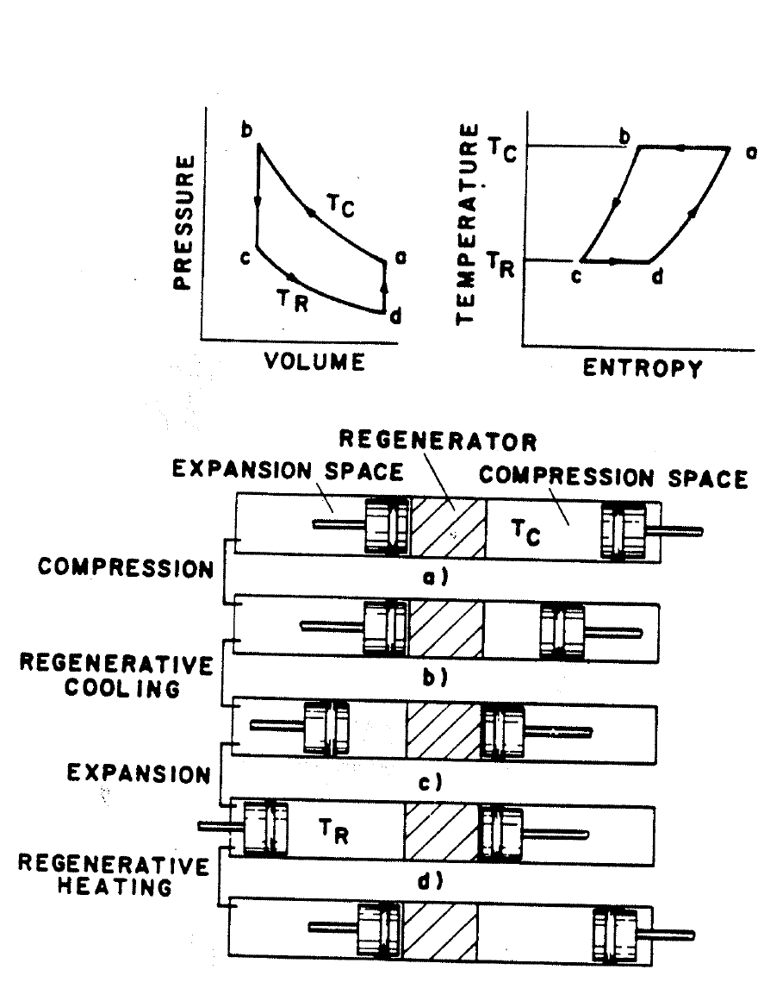
Stirling Cycle Cryocoolers
The cryocooler consists of a compressor, regenerator and displacer
This is an oscillatory cycle
  frequencies ~ 10 – 60 Hz
Steps:
  a-b isothermal compression
    Heat rejected to outside
  b-c regenerative cooling
    constant volume expansion
    Heat transferred to regenerator
  c-d isothermal expansion
    Heat absorbed from cold sink
  d-a regenerative heating
    constant volume compression
    Heat absorbed from regenerator
Courtesy
R. Radebaugh

Slide 11
Coefficient of Performance for an ideal Stirling Cryocooler
Heat rejected to ambient is given by: Q_{r} = mT_{c}(s_{b} - s_{a})
Heat absorbed at the cold end is given by: Q_{a} = mT_{r}(s_{d} - s_{c})
By the first law W_{net} = Q_{r} + Q_{a}
COP = - Q_{a} / W_{net} or
For an ideal gas, the entropy differences are equal and the Stirling COP equals that of the Carnot cycle : COP = T_{r} /(T_{c} – T_{r})
  Don’t be confused, subscripts here refer to previous slide

Slide 12
Real Stirling Cryocoolers
In the real world, cryocoolers are not ideal and typical Figures of Merit are more like 30% Carnot or less
Losses include friction in the compressor motor or displacer, pressure losses in the regenerator and finite temperature differences during heat rejection, absorption and heat transfer within the regenerator.
Advantages of Stirling cycle cryocoolers include:
  Relatively high efficiency
  Small size and weight with the ability to be miniaturized
    very important for military and aerospace applications)
  Moderate cost
  Large production history - more than 140,000 produced to date

Slide 13
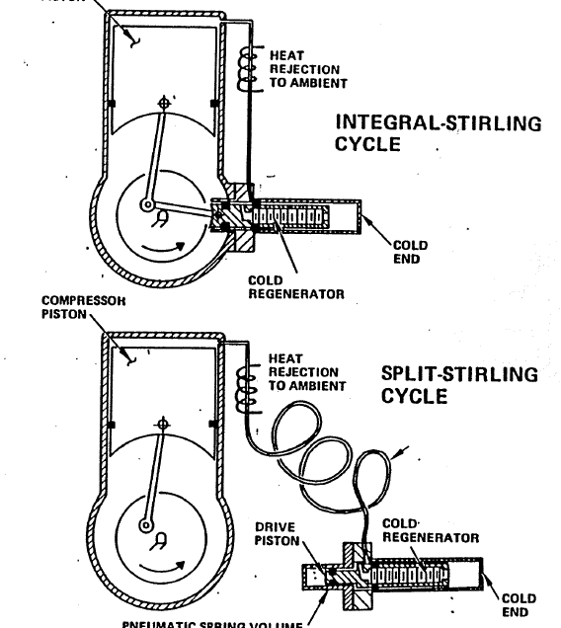
Stirling Crycoolers can be Divided Between Integral and Split
Integral systems can be made very small
Split systems separate out compressor vibrations from the cold end
  However the connecting gas line adds additional frictional losses
Other developments in Stirling cryocoolers include:
  Use of linear motors for compressor
  Development of flexure or gas bearings for moving parts (less chance of contamination & freezing)
  Advanced regenerator materials

Slide 14
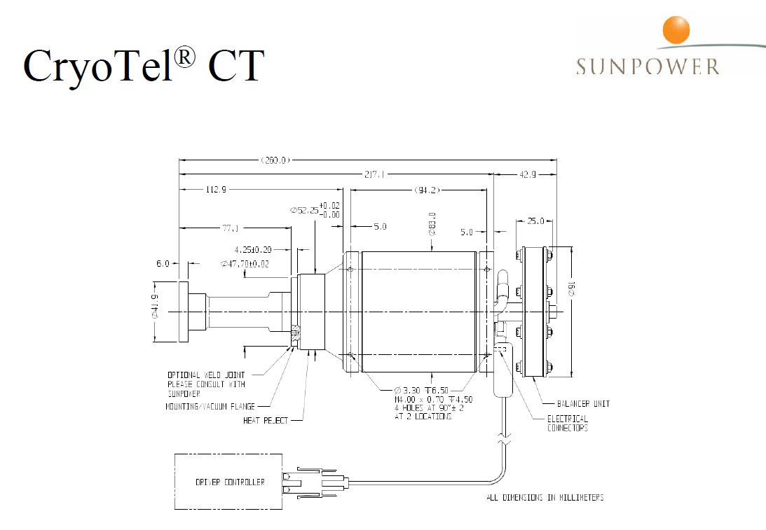
Examples of Stirling Cycle Machines
10 W @ 77 K
3 kg mass
Nominal input power is 160 W
Roughly 18% Carnot

Slide 15
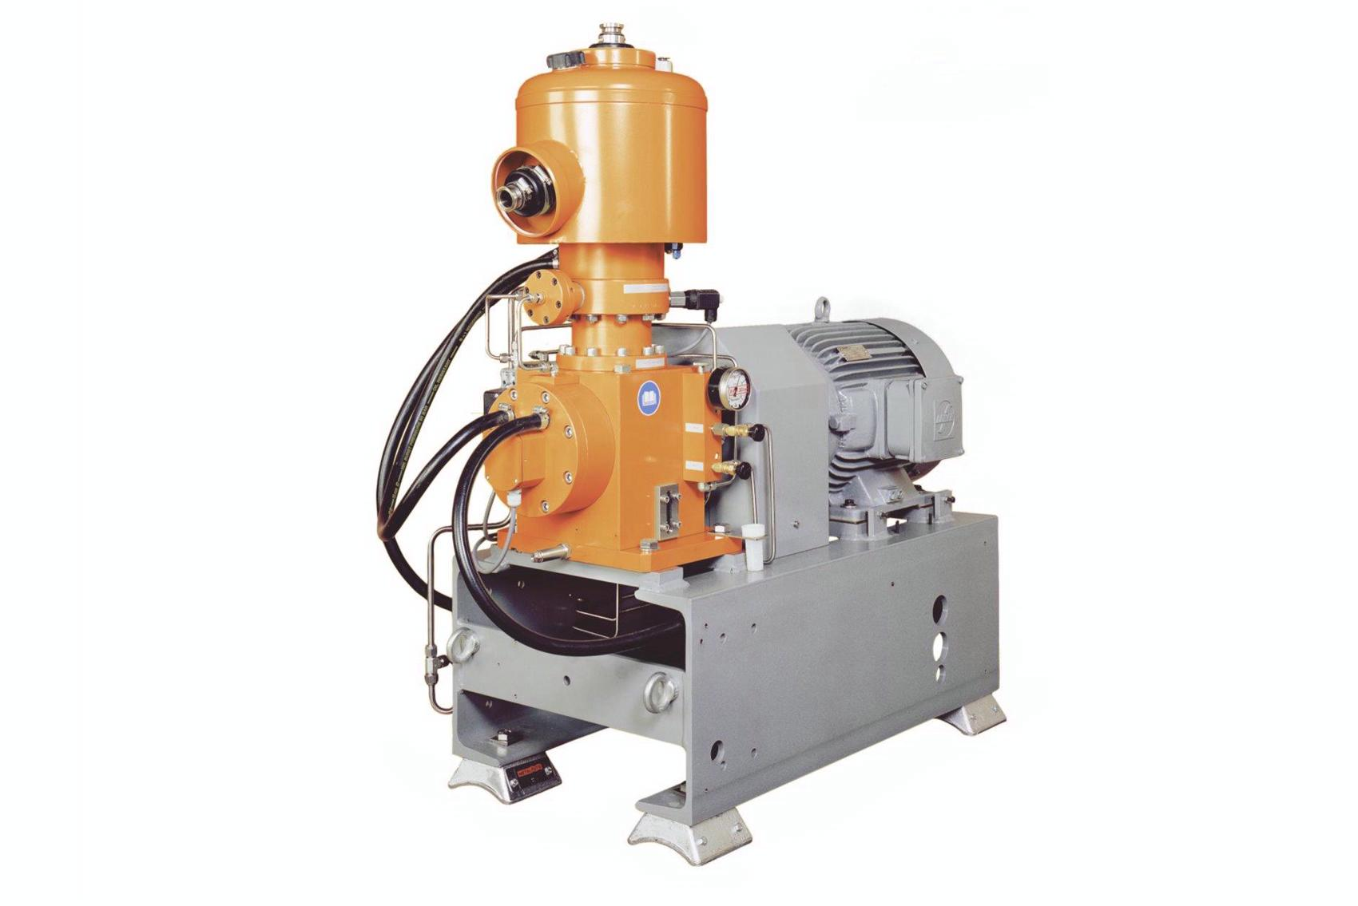
Examples of Stirling Cycle Machines
Model SPC1 produced by Stirling Cryogenics
Roughly 1 kW capacity @ 80 K
Requires 11 kW electrical power for 80 K work
  Roughly 25% Carnot
Not a miniature system, generally used for reliquefaction of LN₂ or process cooling to LN₂
3 currently provide reliquefaction of LN₂ as part of the DEAP 3600 experiment at SNOLAB

Slide 16
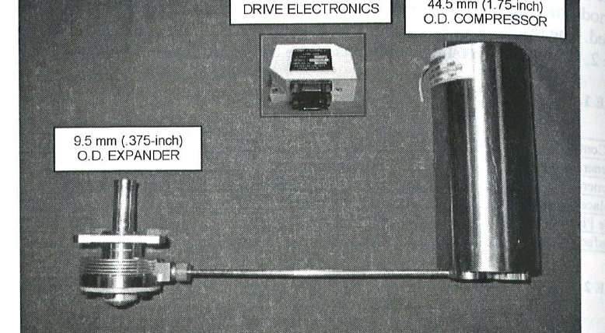
Examples of Stirling Cycle Machines
From:D.T. Kuo et al. “Performance Optimization of L-3 CE 0.6 W Linear Cryocooler” Adv. Cryo Engr. Vol 53 (2008)
Miniaturized split Stirling cycle cryocooler for FLIR sensor applications
2 W at 80 K capacity, requires 70 W input power ~ 8% Carnot
Total mass 800 g

Slide 17
Gifford-McMahon Cryocoolers
Similar in many ways to a Stirling Cycle
Displacer is moved not by a mechanical device but rather by differential gas pressure
Only two moving cold parts: displacer and rotary valve
Use of the valve allows high pressure to be generated by a commercial compressor with an oil removal system
  Lower cost
  More reliable
Design of GM cryocoolers results in more robust but larger systems
GM Cryocoolers can easily be designed with multiple cooling stages at different temperatures

Slide 18
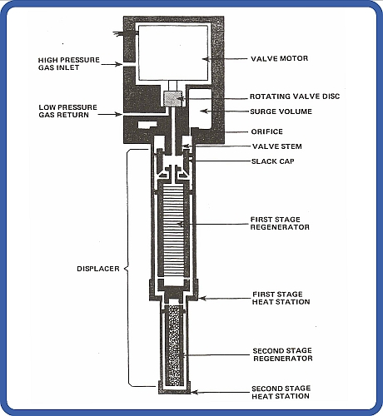
Example of a GM Cryocooler
(Advanced Research Systems)
Typical Uses
  Cryopumping (15 K)
  MRI Magnet Shield Cooling (~50 K)
  MRI Magnet Reliquefiers (4 K)
  HTS electronics ( ~ 60 K)

Slide 19
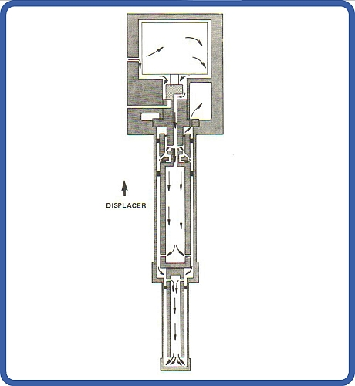
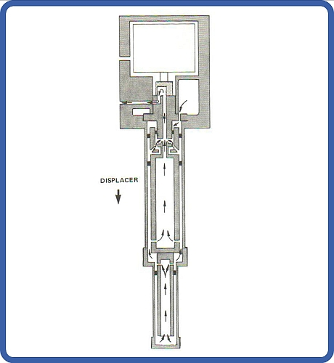
GM Cryocooler Operation
Steps 1 & 2
- High Pressure In
- Expansion
Steps 3 & 4
- Low Pressure Out
- Displacer move down

Slide 20
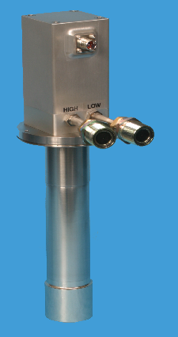
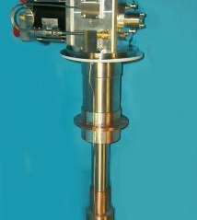
Examples of GM Cryocoolers
Sumitomo
35 W @ 50 K
1.5 W @ 4.2 K
18 kg
CryoMech
60 W @ 80 K

Slide 21
Displacers & Pulse Tube Cryocoolers
GM and Stirling cycle cryocoolers using oscillating flows at 1 – 100 Hz
The cold displacer plays an important role in these devices
  Separate the heating and cooling effects of the cycle by placing the motion of the gas in proper phase with the pressure oscillations
  Little pressure difference across the displacer but a large temperature difference
However the cold displacer leads to a number of problems
  Moving cold part leads to reliability problems and increased vibration at cold end
  Axial heat conduction through the displacer leads to cycle inefficiencies
What if we could eliminate the displacer ?

Slide 22
Pulse Tube Cryocoolers
The gas in the pulse tube in effect replaces the displacer
The pulse tube must be large enough so that the gas in cold end never reaches the warm end and gas in cold end never reaches the warm end
  Thus gas in the middle of tube never leaves the tube and acts as an thermal insulator
  Turbulence & mixing must be minimized
  From this simple design there are many variations of pulse tube cryocoolers

Slide 23
Advantages of Pulse Tube Cryocoolers
High reliability (fewer cold moving parts)
Lower cost
Low vibration
Higher efficiency
Ability to work at all temperature levels
Can be “space qualified”
These advantages and the fact that there is still much to learn about pulse tubes make this a very active area of research
  Roughly 10% of all the papers at the 2009 Cryogenic Engineering Conference dealt with pulse tube cryocoolers
Commercial versions of pulse tube cryocoolers are available

Slide 24
Losses in Pulse Tube Cryocoolers
Regenerator inefficiency (generally the largest single loss)
Losses within the pulse tube itself
  Heat transfer between gas and tube wall
  Mixing of warm and cold gas segments
  Circulation of gas within the pulse tube due to oscillating pressures (acoustic streaming)

Slide 25
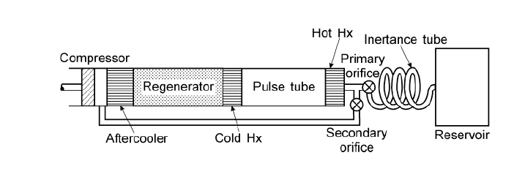
Types of Pulse Tube Cryocoolers
Double Inlet
  Roughly 10% of the flow is bypassed around the regenerator and used to pressurize the reservoir
  Reduces losses in the regenerator
  Increases overall efficiency particularly at higher frequency operations
  Presence of inertance tube (also used on other styles of PT cryocoolers) helps put the flow and pressure oscillations into a phase relationship that optimizes efficiency

Slide 26
Thermoacoustic Drivers
Can result in cryocoolers with no moving parts
Generally only used in very large scale systems
R. Radebaugh – NIST

Slide 27
Different Geometries of Pulse Tube Cryocoolers
Frequently used to separate
compressor vibration from
the cold head
From
R. Radebaugh
NIST

Slide 28
Multistage Cryocoolers
Are Also Common
From Kasthurirengen et al
Proc. ICEC 22 ( 2009)

Slide 29
Pulse Tube and other Cryocooler % Carnot at 80 K
From
R. Radebaugh
NIST

Slide 30
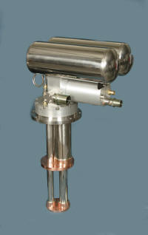
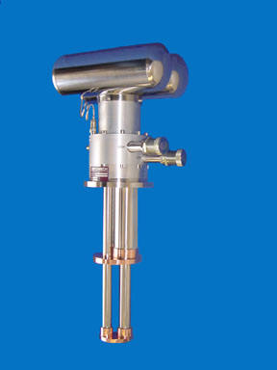
Pulse Tube Cryocoolers
Commercially Available Examples
CryoMech PT810
  14 W @ 20 K
  80 W @ 80 K
CryoMech PT415
  40 W @ 45 K
  1.5 W @4.2 K

Slide 31
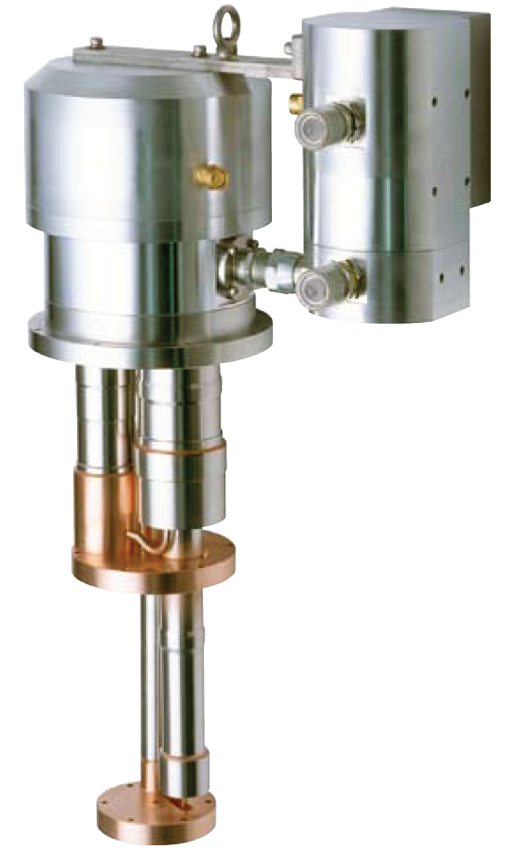
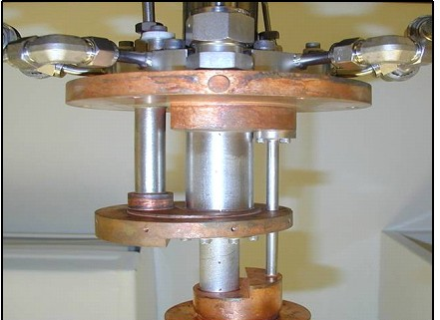
Pulse Tube Cryocoolers
Commercially Available Examples
SHI Cryogenics SRP-062B
  30 W @ 65 K
  0.5 W @ 4.2 K
  6.5 kW power input
Sierra Lobo
  4 W @ 65 K
  4 W @ 20 K
  Can be used for Zero Boil Off Propellant Storage

Slide 32
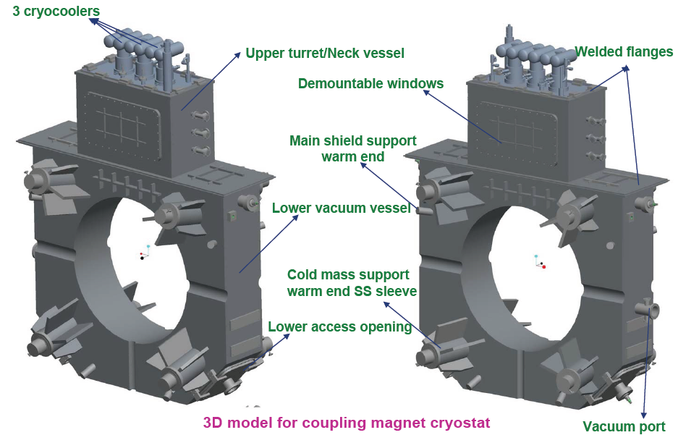
Example of Pulse Tube Cryocoolers in Accelerators (MICE experiment)
3 x 1.5 W PT CCs to
reliquify He
in the MICE
Coupling coil design
7 T Solenoid
Field

Slide 33
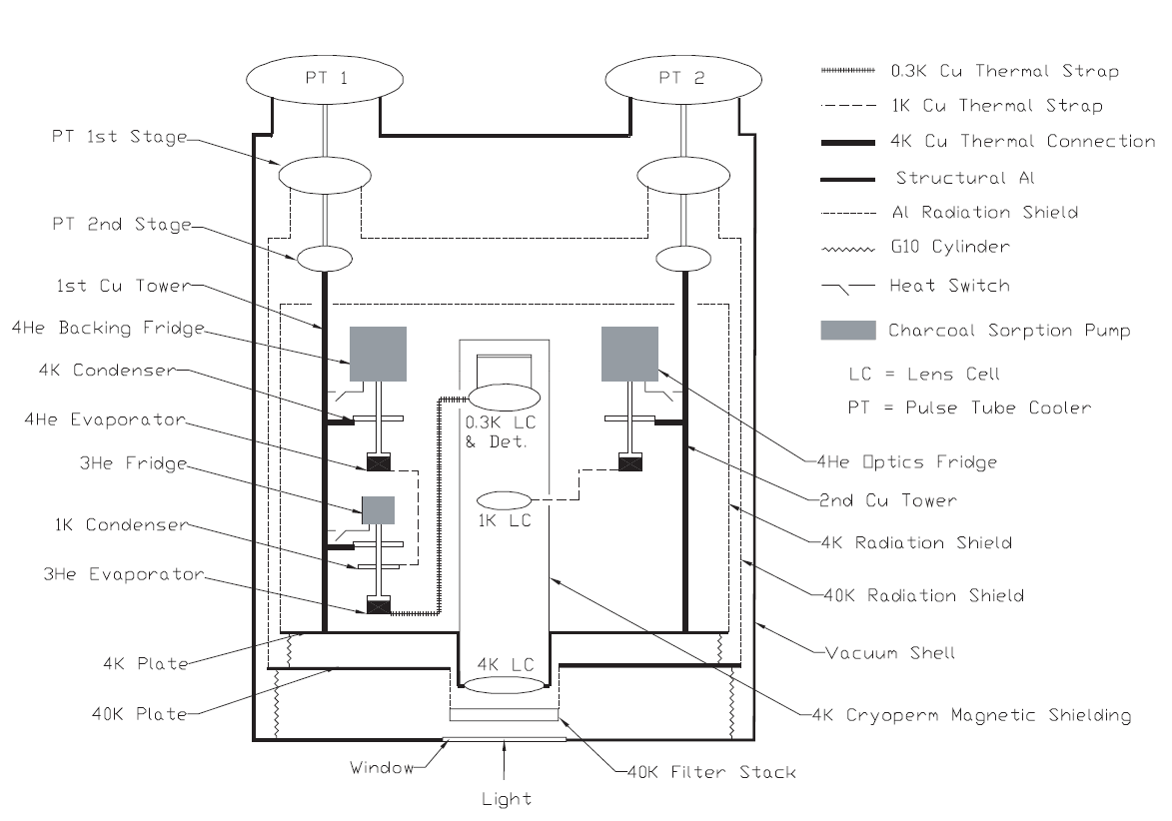
Example of PT Use
Atacama Cosmology Telescope
Remote site
Liquid cryogens a problem
Uses 2 PT from Cryomech
40 W @ 45 K
1 W @ 4.5 K
From D.S. Swetz Atacama Cosmology Telescope
PhD dissertation U. Penn 2009

Slide 34
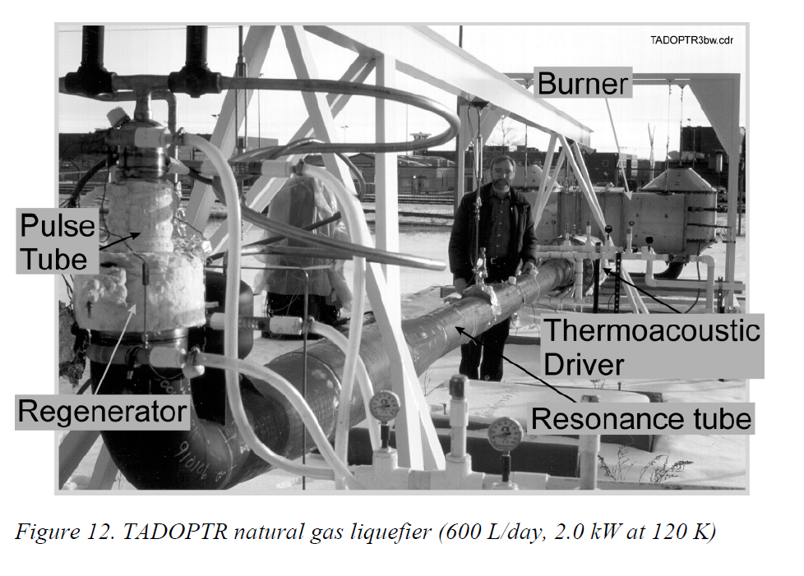
Example of PT use
LNG production using a TADOPTR
No moving parts
burns 1/3 of natural
gas stream
to liquefy the rest
From
R. Radebaugh
NIST

Slide 35
Space Applications
19 W @ 90 K
222 W input power
Both figures From R. Radebaugh Proc. Instit. of Refrig.
0.5 W @ 55 K

Slide 36
Space Applications
0.5 W @ 58 K
Atmospheric Infrared Sounder
On orbit for the last 8 years
2.3 W @ 53 K and 8 W @ 183 K
Designed for sensor cooling on NASA GOES-R Satellite
Colbert et al.
Cryocoolers 15 (2009)
Ross et al.
Cryocoolers 15 (2009)

Slide 37
Summary
Cryocoolers are becoming more and more common in physics and accelerator applications.
  Improved technology (bearings, miniaturized compressors, better materials, CFD, better reliability etc.) has lead to the development of a large number of practical cryocooler designs in the past 10 – 20 years
A significant industrial base exists for these devices
Pulse tube cryocoolers, in particular, are a very active area of cryogenic research
Their potential for low vibration and high reliability make them particularly attractive to space applications
They are a Some additional online resources for pulse tubes and other types of cryocoolers are:
  http://www.cryocooler.org/ Contains online proceedings of the International Cryocooler Conferences
http://www.elsevier.com/wps/find/journaldescription.cws_home/30407/description#description Online link to the journal Cryogenics which includes proceedings of the Space cryogenics Workshops

